Slide 1
11.3 Universal Approximation of Real Data

Slide 2
Prototypical examples

Slide 3
Example: Universal approximation of real regression data

Slide 4
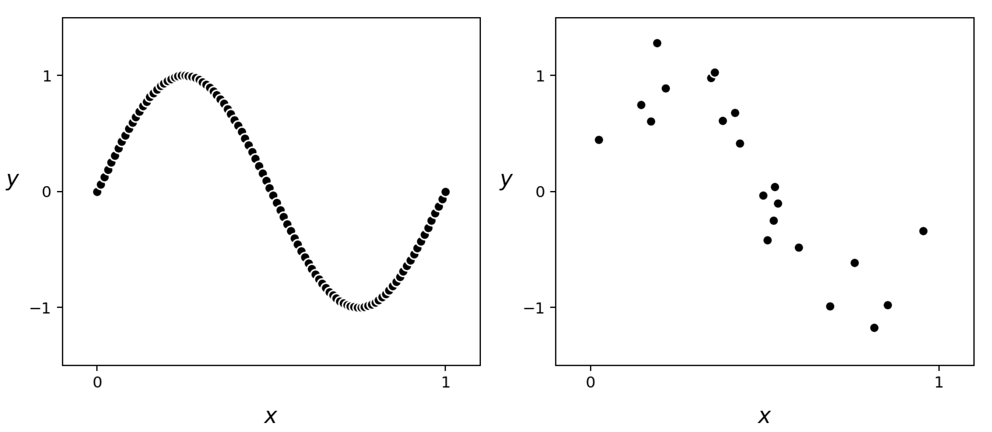
(left panel) A *near-perfect* sinusoidal dataset. (right panel) A *real* regression dataset formed by adding random noise to the output of a small subset of the dataset on the right.

Slide 5
In the following animation we illustrate the fully tuned nonlinear fit of a model employing 1 through 20 polynomial, neural network, and stump units.

Slide 6
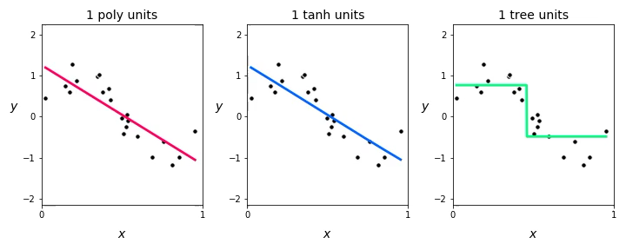

Slide 7
Notice how:
with each of the universal approximators, all three models *underfit* the data when using only B = 1 unit in each case.
each model improves as we increase B, but only up to a certain point after which each *tuned* model becomes far too complex and overfits the data.

Slide 8
The following animation shows several polynomial-based models along with the corresponding Least Squares cost value each attains, i.e., the model's *training error*.

Slide 9
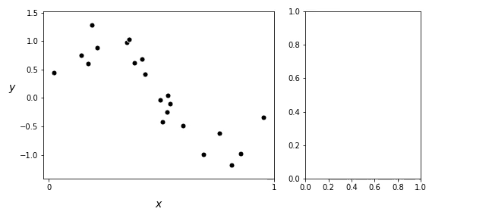

Slide 10
Notice how:
in adding more polynomial units we turn up the capacity of our model and, optimizing each model to completion, the resulting tuned models achieve lower and lower training error.
the resulting fit provided by each fully tuned model (after a certain point) becomes far too complex and starts to get *worse* in terms of how it represents the general regression phenomenon.
as a measurement tool the training error only tells us how well a tuned model fits the *training data*, but fails to tell us when our tuned model becomes too complex.

Slide 11
Example: Universal approximation of real classification data

Slide 12
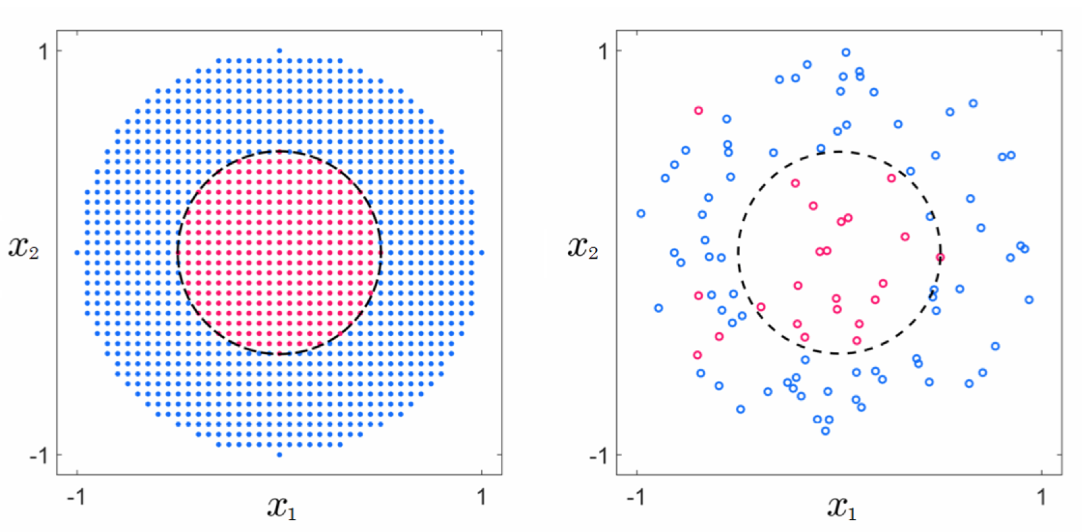
(left panel) A near-perfect classification dataset. (right panel) A real dataset formed from a noisy subset of these points.

Slide 13
In the following animation we show the nonlinear decision boundaries provided by fully tuned models employing polynomial, neural network, and stump units.

Slide 14
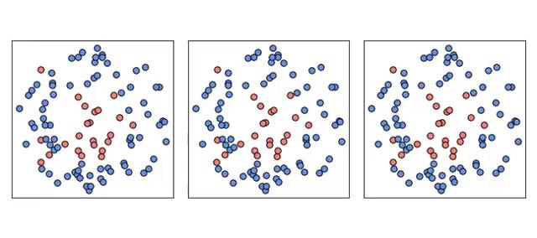

Slide 15
Notice how:
at the start all three tuned models are not complex enough and thus *underfit* the data, providing a classification that in all instances simply classifies the entire space as belonging to the blue class.
each model improves as more units are added, with B = 5 polynomial units, B = 3 neural network units, and B = 5 stump units providing reasonable approximations to the desired circular decision boundary.
soon after we reach these numbers of units each tuned model becomes too complex and *overfits* the training data.

Slide 16
In the following animation we plot several neural network-based models along with the corresponding two-class Softmax cost value each attains.

Slide 17
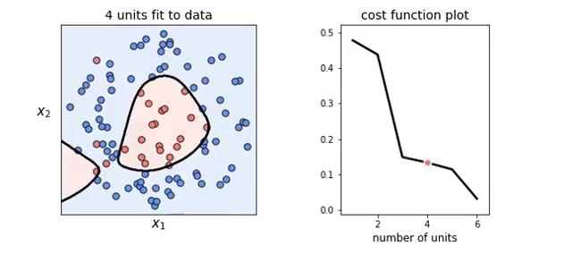

Slide 18
Notice how:
increasing model capacity by adding more units always *decreases* the cost function value (just as with perfect or near-perfect data).
the resulting classification, after a certain point, actually gets *worse* in terms of how it (the learned decision boundary) represents the general classification phenomenon.

Slide 19
The capacity and optimization dials, revisited

Slide 20
When dealing with perfect data the best setting of capacity/optimization dials is when both dials are set all the way to the right.
This means employing a model with maximum possible capacity and minimizing its corresponding cost to completion.
The prototypical examples we just saw illustrate how with real data we cannot simply set our capacity and optimization dials all the way to the right.

Slide 21
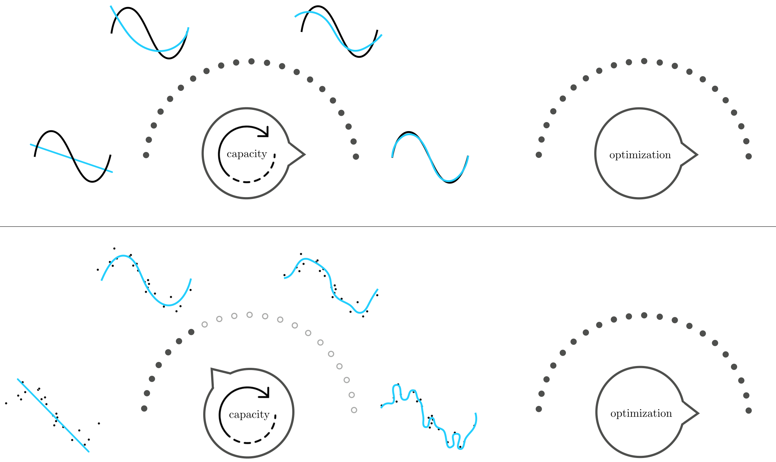
Setting the optimization dial all the way to the right, with real data (unlike perfect data) we cannot simply set our capacity dial all the way to the right as well!

Slide 22
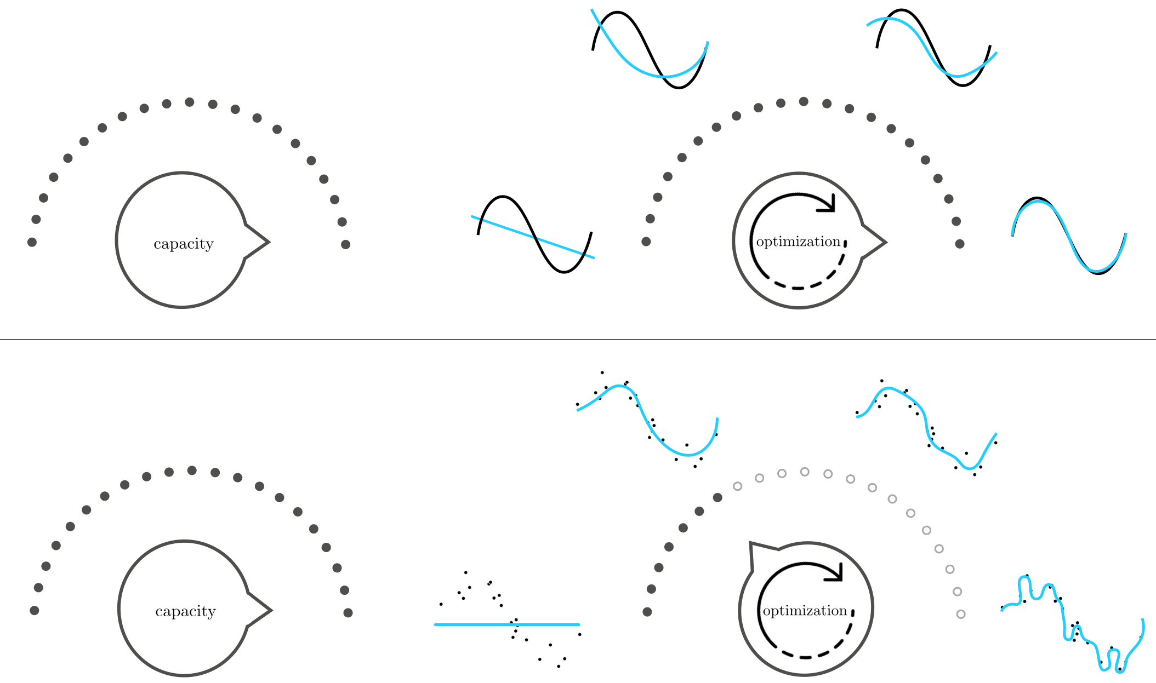
Setting the capacity dial all the way to the right, with real data (unlike perfect data) we cannot simply set our optimization dial all the way to the right as well!

Slide 23
Motivating a new measurement tool

Slide 24
How we set our capacity and optimization dials in order to achieve a final tuned model that has *just the right amount of complexity* for a given dataset is the main challenge we face when employing universal approximator-based models with real data.

Slide 25
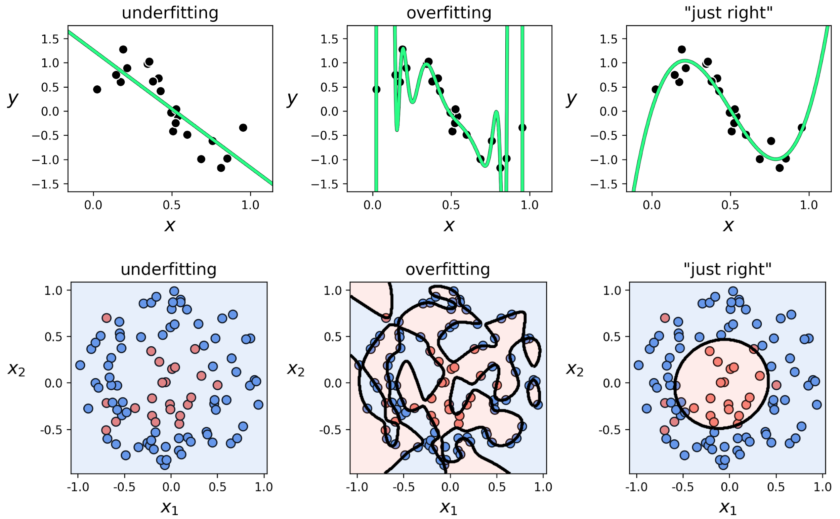
What do both the underfitting and overfitting patterns have in common, that the "just right" model does not?

Slide 26
Observation
While the underfitting and overfitting models differ in how well they represent data *we already have*, they will both fail to adequately represent *new data* generated via the same process by which the current data was made.

Slide 27
Question
But how do we quantify something we will receive in the future?

Slide 28
The validation error

Slide 29
To simulate the data we receive in the future, we simply remove a random portion of our data and treat it as "new data we might receive in the future." We train our selection of models on only the portion of data that remains, and *validate* the performance of each model on this randomly removed chunk of "new" data.

Slide 30
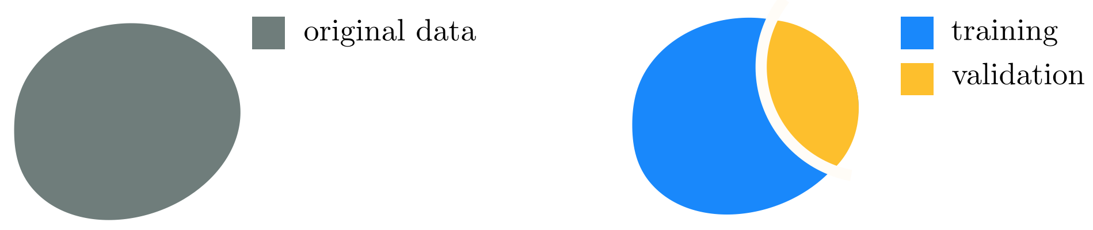
The random portion of the data we remove to validate our model(s) is commonly called the *validation data*
The remaining portion we use to train models is likewise referred to as the *training data*

Slide 31
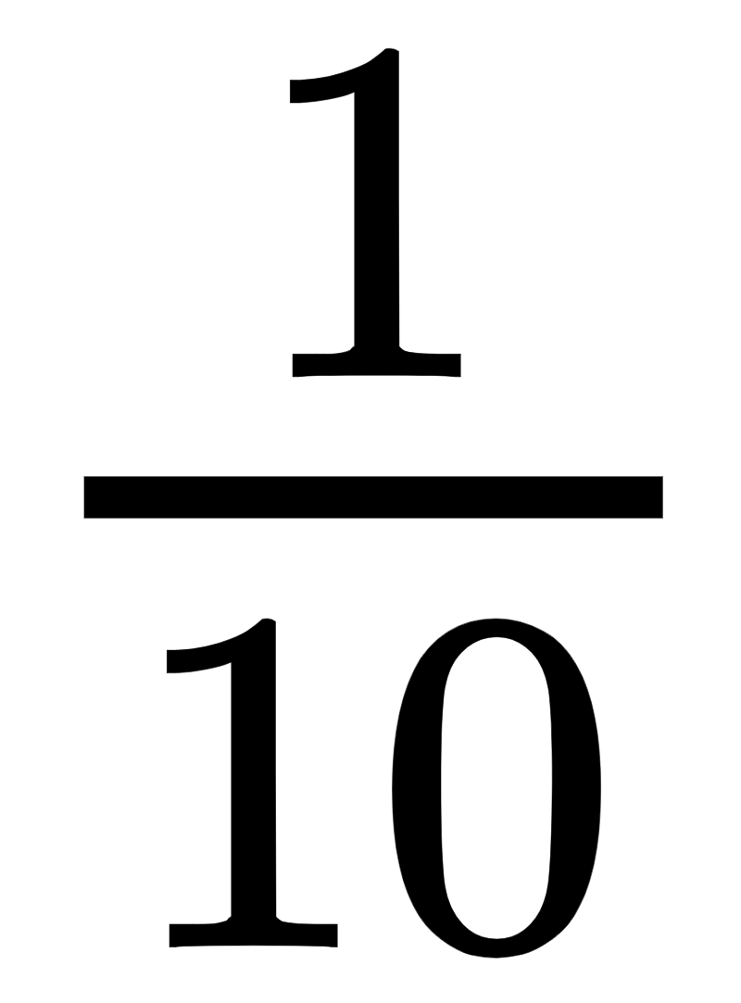
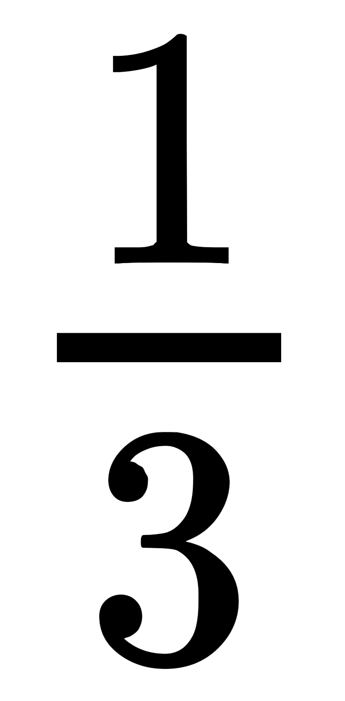
There is no precise rule for what portion of a given dataset should be saved for validation.
In practice, typically between to of the data is assigned to the validation set.
Generally speaking, the larger and/or more representative (of the true phenomenon from which the data is sampled) a dataset is the larger the portion of the original data may be assigned to the validation set (e.g., ).

